Slide 1
Design and Analysis of Algorithms CS345
Lecture 24
Generalization of Maximum Flow - II

Slide 2
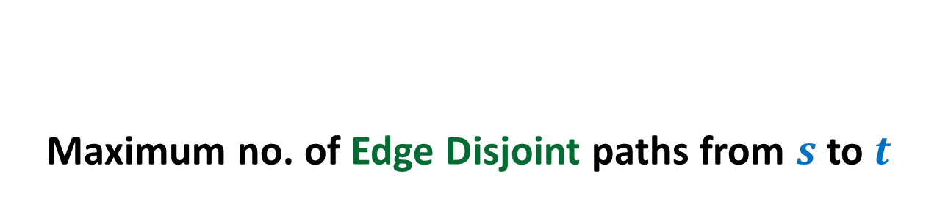
Applications of max-flow
Maximum no. of Edge Disjoint paths from $s$ to $t$

Slide 3
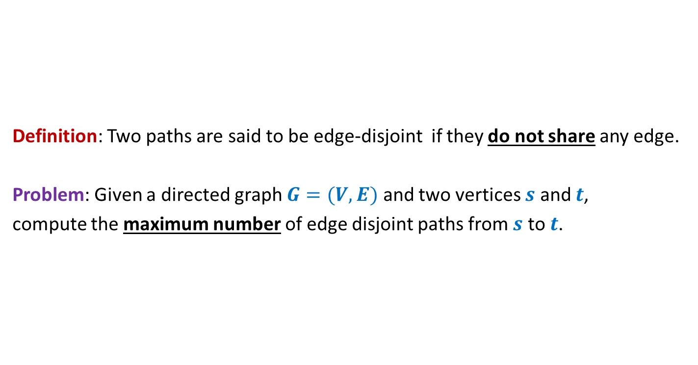
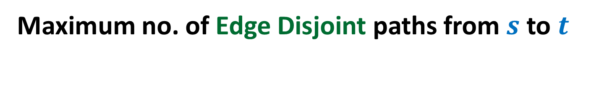
Maximum no. of Edge Disjoint paths from $s$ to $t$
Definition: Two paths are said to be edge-disjoint if they do not share any edge.
Problem: Given a directed graph $G=(V,E)$ and two vertices $s$ and $t$,
compute the maximum number of edge disjoint paths from $s$ to $t$.

Slide 4




Maximum no. of Edge Disjoint paths from $s$ to $t$
Intuition: View $G$ as a flow network, and compute max-flow from $s$ to $t$.
Question: What will be capacities of edges ?
Answer: unit capacity.
Question: What relationship exists between the two instances ?
A natural guess/intuition➔
maximum no. of $s$-$t$ paths in $G$ = max-flow from $s$ to $t$in the corresponding flow network.
$$G$$
$$s$$
$$t$$

Slide 5

Maximum no. of Edge Disjoint paths from $s$ to $t$
Theorem:
maximum no. of $s$-$t$ paths in $G$ =
max-flow from $s$ to $t$in the corresponding flow network.
$$G$$
$$s$$
$$t$$

Slide 6

Maximum no. of Edge Disjoint paths from $s$ to $t$
Theorem:
There are $k$ edge disjoint paths from $s$ to $t$ in $G$
if and only if
there is a flow of value $k$ from $s$ to $t$in corresponding flow network
$$G$$
$$s$$
$$t$$

Slide 7
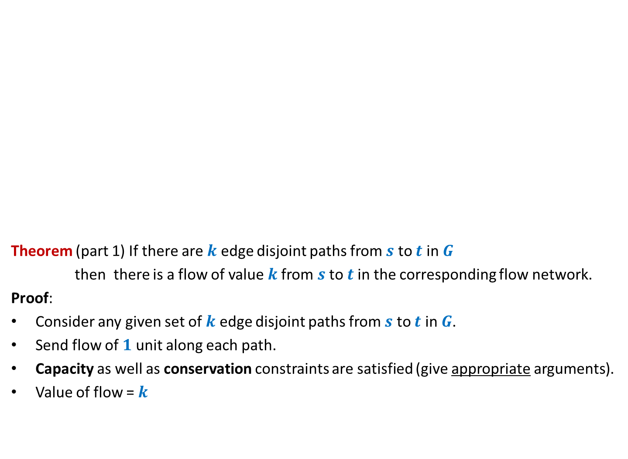
Maximum no. of Edge Disjoint paths from $s$ to $t$
Theorem (part 1) If there are $k$ edge disjoint paths from $s$ to $t$ in $G$
then there is a flow of value $k$from $s$ to $t$in the corresponding flow network.
Proof:
Consider any given set of $k$ edge disjoint paths from $s$ to $t$ in $G$.
Send flow of $1$ unit along each path.
Capacity as well as conservation constraints are satisfied (give appropriate arguments).
Value of flow = $k$
$$G$$
$$s$$
$$t$$

Slide 8

Maximum no. of Edge Disjoint paths from $s$ to $t$
Theorem (part 2) If there is a flow of value $k$from $s$ to $t$in the flow network
then there are $k$ edge disjoint paths from $s$ to $t$ in $G$.
Proof:
and
➔there exists a flow $f$ of value $k$such that $f \left(e\right)=1$or $0$for all $e∈E$.
Aim: To construct $k$ edge disjoint paths from $s$ to $t$ using edges carrying unit flow.
$$G$$
$$s$$
$$t$$
Integrality of flow
Unit edge capacity

Slide 9

Maximum no. of Edge Disjoint paths from $s$ to $t$
Theorem (part 2) If there is a flow of value $k$from $s$ to $t$in the flow network
then there are $k$ edge disjoint paths from $s$ to $t$ in $G$.
Proof: “Keep following any stream of flow originating from $s$ and terminating at $t$”.
What if we get caught in a loop ☹?
But is it possible in a flow ?
Yes, INDEED.
$$G$$
$$s$$
$$t$$

Slide 10

Maximum no. of Edge Disjoint paths from $s$ to $t$
Theorem (part 2) If there is a flow of value $k$from $s$ to $t$in the flow network
then there are $k$ edge disjoint paths from $s$ to $t$ in $G$.
$$G$$
$$s$$
$$t$$
Using the last animation as a hint,
make sincere attempts to think of the Theorem.

Slide 11
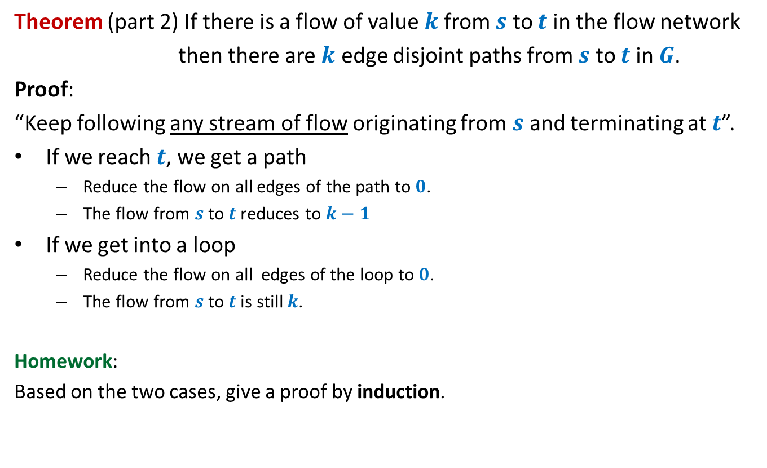
Maximum no. of Edge Disjoint paths from $s$ to $t$
Theorem (part 2) If there is a flow of value $k$from $s$ to $t$in the flow network
then there are $k$ edge disjoint paths from $s$ to $t$ in $G$.
Proof:
“Keep following any stream of flow originating from $s$ and terminating at $t$”.
If we reach $t$, we get a path
Reduce the flow on all edges of the path to $0$.
The flow from $s$ to $t$reduces to $k−1$
If we get into a loop
Reduce the flow on all edges of the loop to $0$.
The flow from $s$ to $t$is still $k$.
Homework:
Based on the two cases, give a proof by induction.

Slide 12
An inspirational problem

Slide 13
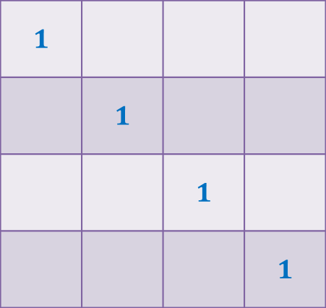
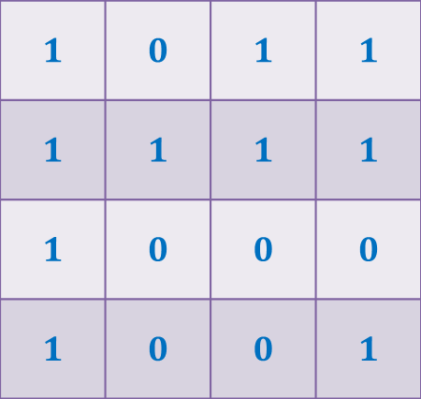
Diagonal-Unit matrix
Definition:
A Boolean matrix is a Diagonal-Unit matrix if all entries on its diagonal are $1$.
Column-swap operation
Row-swap operation
Not a Diagonal-Unit matrix
a Diagonal-Unit matrix
$$1$$ | $$0$$ | $$1$$ | $$1$$
$$1$$ | $$1$$ | $$1$$ | $$1$$
$$1$$ | $$0$$ | $$0$$ | $$0$$
$$1$$ | $$0$$ | $$0$$ | $$1$$
$$1$$
 | $$1$$
 |  | $$1$$
 |  |  | $$1$$
?
Problem: Design an efficient algorithm to determine if we can transform a given Boolean matrix to a Diagonal-unit matrix using any sequence of swaps of rows or columns.

Slide 14
Generalization of max-flow Problem
Part 2 Extending the capacity constraint
Let us first have a motivating problem that is solved using this generalization. ☺

Slide 15
Generalization of max-flow Problem
Part 2 Extending the capacity constraint

Slide 16
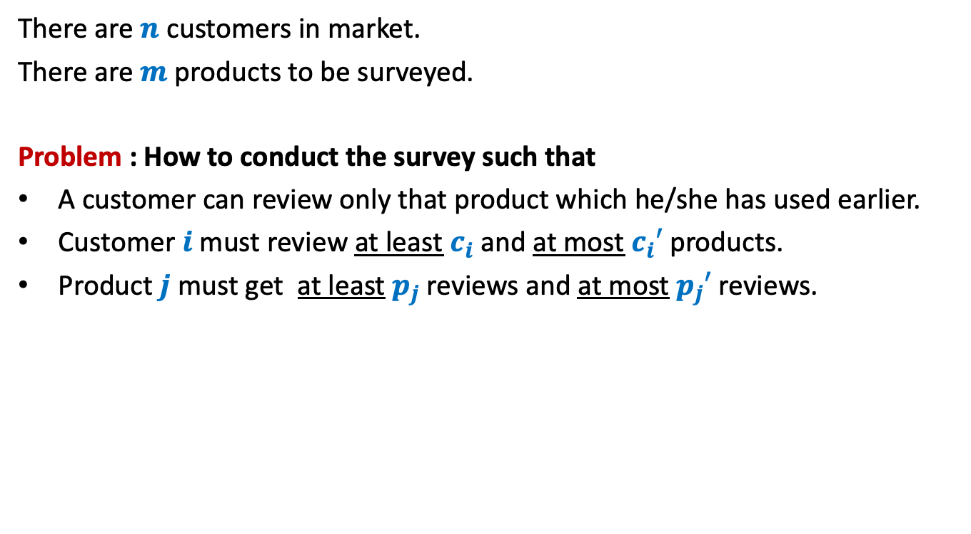
Survey Design Problem (As a motivating example)
There are $n$ customers in market.
There are $m$ products to be surveyed.
Problem : How to conduct the survey such that
A customer can review only that product which he/she has used earlier.
Customer $i$must review at least $c_{i}$and at most $c_{i}′$ products.
Product $j$must get at least $p_{j}$reviews and at most $p_{j}′$reviews.
Does this problem seem to have anything to do with flow ?
At least it does not appear on the first glance.

Slide 17
Generalization of max-flow Problem
Part 1 Extending the conservation constraint

Slide 18
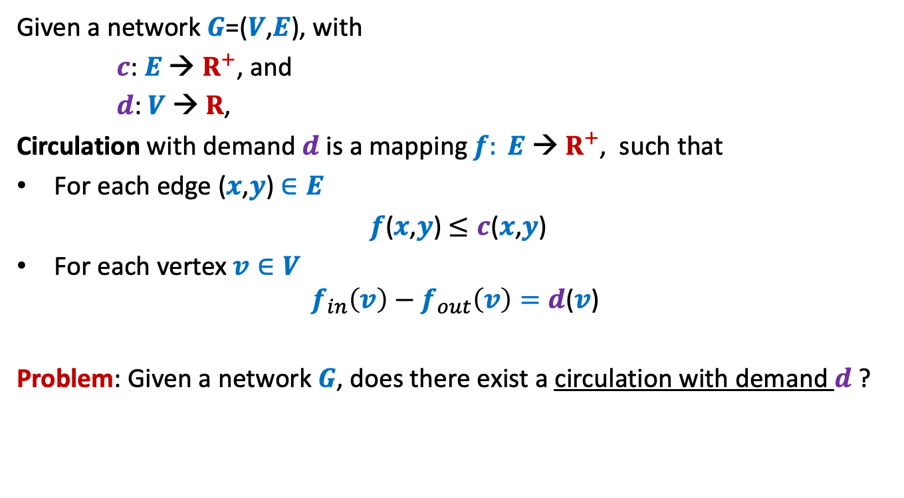
Circulation with demand
Given a network $G$=($V$,$E$), with
$c$: $E$ → $R^{+}$, and
$d$: $V$ → $R$,
Circulation with demand $d$is a mapping $f: E \text{→} R^{+}$, such that
For each edge ($x$,$y$) $∈E$
$f$($x$,$y$) $≤c$($x$,$y$)
For each vertex $v∈V$
$$f_{in}\left(v\right)−f_{out}\left(v\right)=d\text{(}v\text{)}$$
Problem: Given a network $G$, does there exist a circulation with demand $d$ ?

Slide 19
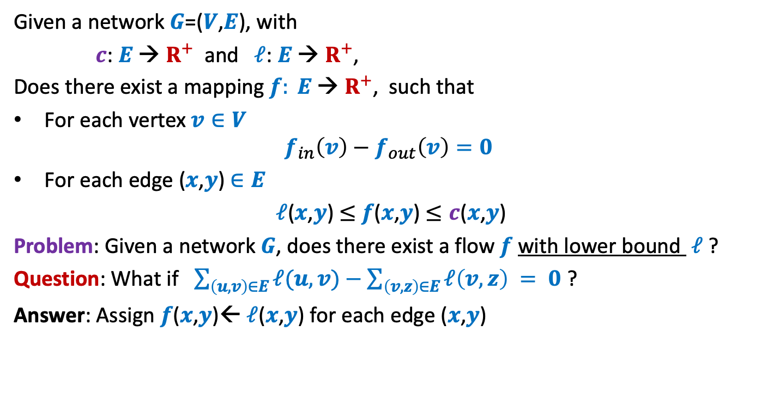
Flow with lower bound
Given a network $G$=($V$,$E$), with
$c$: $E$ → $R^{+}$ and $ℓ$: $E$ → $R^{+}$,
Does there exist a mapping $f: E \text{→} R^{+}$, such that
For each vertex $v∈V$
$$f_{in}\left(v\right)−f_{out}\left(v\right)=0$$
For each edge ($x$,$y$) $∈E$
$ℓ$($x$,$y$) $≤$ $f$($x$,$y$) $≤c$($x$,$y$)
Problem: Given a network $G$, does there exist a flow $f$with lower bound $ℓ$ ?
Question: What if $\sum_{\left(u,v\right)∈E}{ℓ(u,v)}−\sum_{\left(v,z\right)∈E}{ℓ\left(v,z\right)} = 0$ ?
Answer: Assign $f$($x$,$y$)← $ℓ$($x$,$y$) for each edge ($x$,$y$)

Slide 20

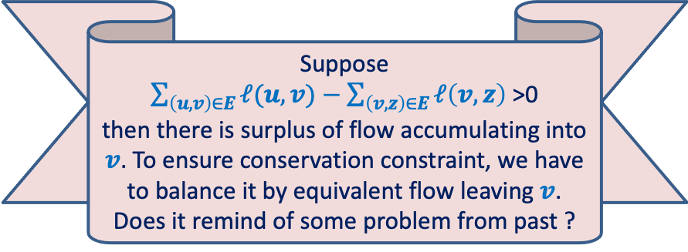

Flow with lower bound
Given a network $G$=($V$,$E$), with
$c$: $E$ → $R^{+}$ and $ℓ$: $E$ → $R^{+}$,
Does there exist a mapping $f: E \text{→} R^{+}$, such that
For each vertex $v∈V$
$$f_{in}\left(v\right)−f_{out}\left(v\right)=0$$
For each edge ($x$,$y$) $∈E$
$ℓ$($x$,$y$) $≤$ $f$($x$,$y$) $≤c$($x$,$y$)
Problem: Given a network $G$, does there exist a flow $f$with lower bound $ℓ$ ?
Question: What if $\sum_{\left(u,v\right)∈E}{ℓ(u,v)}−\sum_{\left(v,z\right)∈E}{ℓ\left(v,z\right)} = 0$ ?
Answer: Assign $f$($x$,$y$)← $ℓ$($x$,$y$) for each edge ($x$,$y$)
$$≠$$
Suppose
$\sum_{\left(u,v\right)∈E}{ℓ(u,v)}−\sum_{\left(v,z\right)∈E}{ℓ\left(v,z\right)}$>0
then there is surplus of flow accumulating into $v$. To ensure conservation constraint, we have to balance it by equivalent flow leaving $v$.
Does it remind of some problem from past ?
Reduce to
circulation with demand
$$v$$

Slide 21
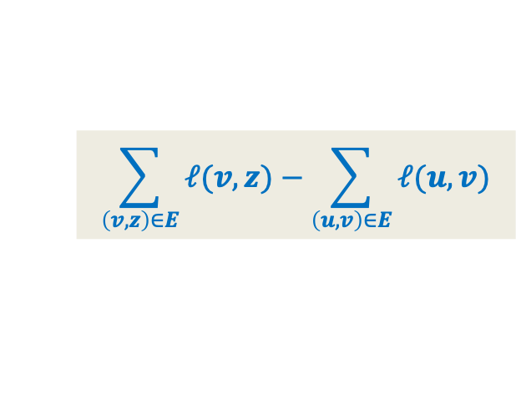
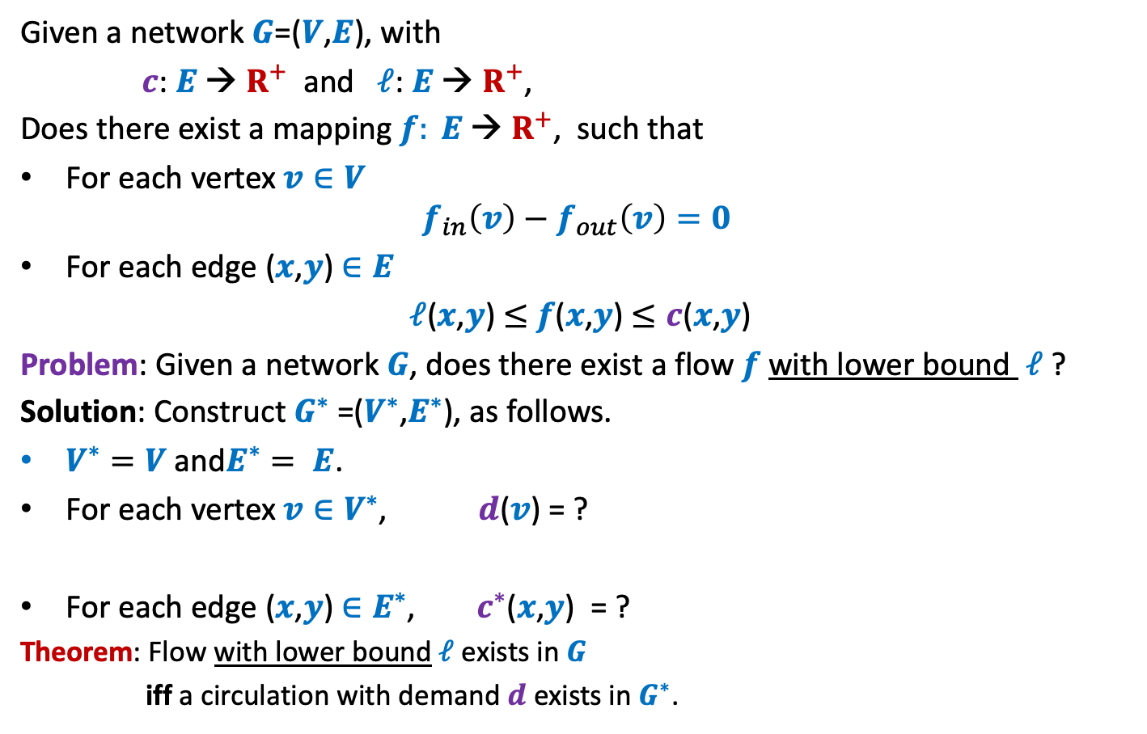

Flow with lower bound
Given a network $G$=($V$,$E$), with
$c$: $E$ → $R^{+}$ and $ℓ$: $E$ → $R^{+}$,
Does there exist a mapping $f: E \text{→} R^{+}$, such that
For each vertex $v∈V$
$$f_{in}\left(v\right)−f_{out}\left(v\right)=0$$
For each edge ($x$,$y$) $∈E$
$ℓ$($x$,$y$) $≤$ $f$($x$,$y$) $≤c$($x$,$y$)
Problem: Given a network $G$, does there exist a flow $f$with lower bound $ℓ$ ?
Solution: Construct $G^{∗}$ =($V^{∗}$,$E^{∗}$), as follows.
$V^{∗}=V$ and$E^{∗}= E$.
For each vertex $v∈V^{∗}$, $d$($v$) = ?
For each edge ($x$,$y$) $∈E^{∗}$, $c^{∗}$($x$,$y$) = ?
Theorem: Flow with lower bound$ℓ$ exists in $G$
iff a circulation with demand $d$ exists in $G^{∗}$.
$$\sum_{\left(v,z\right)∈E}{ℓ(v,z)}−\sum_{\left(u,v\right)∈E}{ℓ(u,v)}$$
$c$($x$,$y$) $− ℓ$($x$,$y$)
Homework: Prove the Theorem.

Slide 22
Applications of Flow with lower bound
Designing a Survey

Slide 23
Survey Design Problem (As a motivating example)
There are $n$ customers in market.
There are $m$ products to be surveyed.
Problem : How to conduct the survey such that
A customer can review only that product which he/she has used earlier.
Customer $i$must review at least $c_{i}$and at most $c_{i}′$ products.
Product $j$must get at least $p_{j}$reviews and at most $p_{j}′$reviews.
How to formulate the problem
as an instance of
a feasible flow with lower bound ?

Slide 24

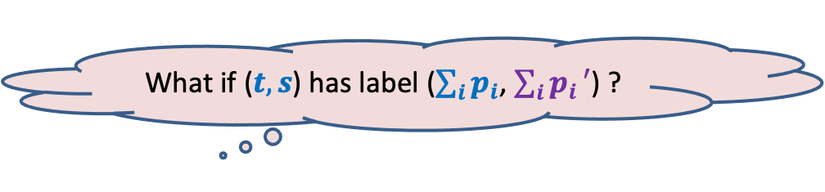







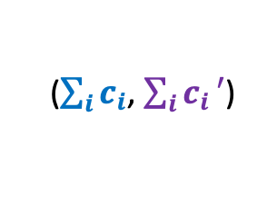



Survey Design Problem
$$G$$
($0$,$1$)
Constraints:
A customer can review only that product which he/she has used earlier.
Customer $i$must review at least $c_{i}$and at most $c_{i}′$ products.
Product $j$must get at least $p_{j}$reviews and at most $p_{j}′$reviews.
Theorem: Survey Design is possible
if and only if
the corresponding flow with lower bound is feasible in $G$ ?
Customers
Products
$$s$$
$$t$$
($p_{j},p_{j}′$)
($c_{i},c_{i}′$)
$$j$$
$$i$$
How to conserve flow at $s$ and $t$ ?
($\sum_{i}{c_{i}}$, $\sum_{i}{c_{i}}′$)
What if ($t,s$) has label ($\sum_{i}{p_{i}}$, $\sum_{i}{p_{i}}′$) ?
What if ($t,s$) has label ($0$, $∞$) ?
Make a sincere attempt to prove this Theorem on your own before seeing it on the next 2 slides.

Slide 25
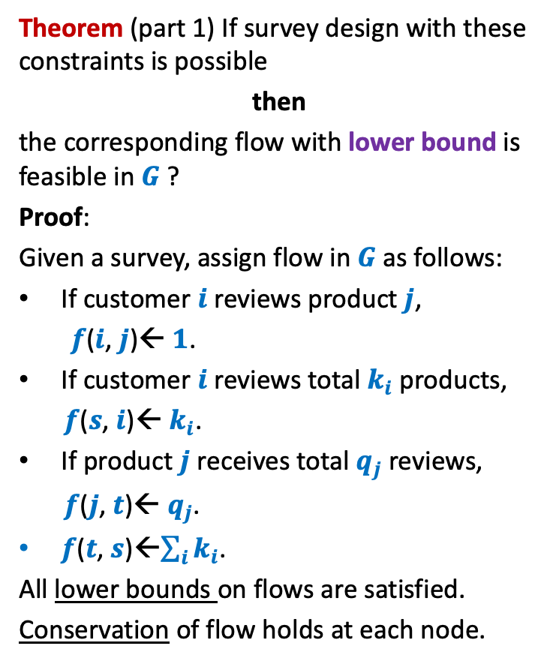
Survey Design Problem
$$G$$
Theorem (part 1) If survey design with these constraints is possible
then
the corresponding flow with lower bound is feasible in $G$ ?
Proof:
Given a survey, assign flow in $G$ as follows:
If customer $i$ reviews product $j$,
$f$($i$, $j$)← $1$.
If customer $i$ reviews total $k_{i}$ products,
$f$($s$, $i$)← $k_{i}$.
If product $j$ receives total $q_{j}$ reviews,
$f$($j$, $t$)← $q_{j}$.
$f$($t$, $s$)←$\sum_{i}{k_{i}}$.
All lower bounds on flows are satisfied.
Conservation of flow holds at each node.
($0$,$1$)
Customers
Products
$$s$$
$$t$$
($p_{j},p_{j}′$)
($c_{i},c_{i}′$)
$$j$$
$$i$$
($\sum_{i}{c_{i}}$, $\sum_{i}{c_{i}}′$)

Slide 26

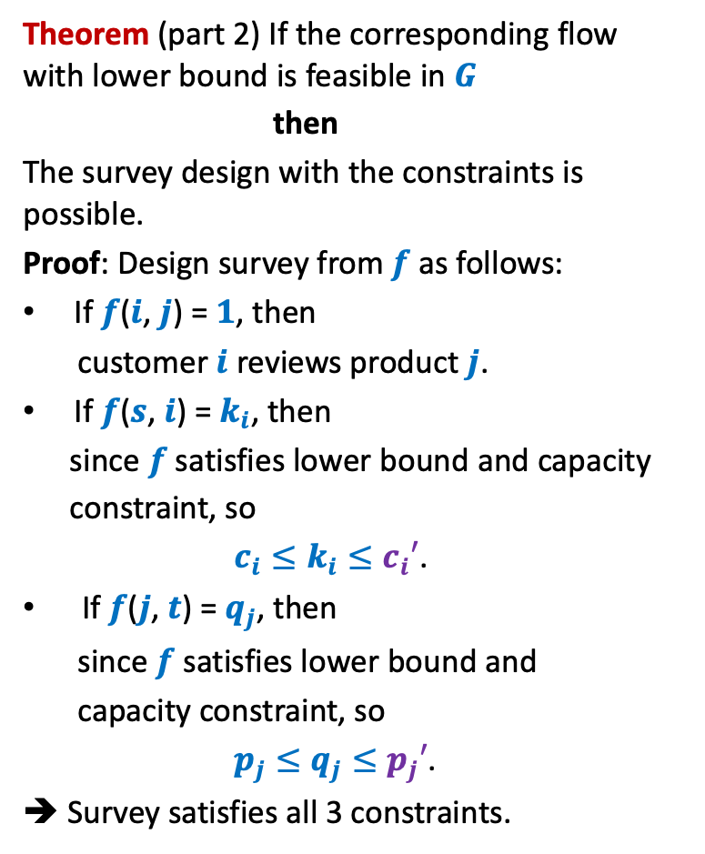

Survey Design Problem
$$G$$
Theorem (part 2) If the corresponding flow with lower bound is feasible in $G$
then
The survey design with the constraints is possible.
Proof: Design survey from $f$as follows:
If $f$($i$, $j$) = $1$, then
customer $i$ reviews product $j$.
If $f$($s$, $i$) = $k_{i}$, then
since $f$ satisfies lower bound and capacity
constraint, so
$c_{i}≤k_{i}≤c_{i}′$.
If $f$($j$, $t$) = $q_{j}$, then
since $f$ satisfies lower bound and
capacity constraint, so
$p_{j}≤q_{j}≤p_{j}′$.
➔ Survey satisfies all 3 constraints.
($0$,$1$)
Customers
Products
($c_{i},c_{i}′$)
$$i$$
$$s$$
$$t$$
($p_{j},p_{j}′$)
$$j$$
($\sum_{i}{c_{i}}$, $\sum_{i}{c_{i}}′$)

Slide 27
Applications of Flow with lower bound
An Airline Problem

Slide 28











An Airline Problem
There are $n$ cities to be served.
There are $m$ fights to be operated.
Flight $i$ has $4$ parameters:
$s$($i$) : source
$d$($i$) : destination
dep($i$) : departure time
arr($i$) : arrival time
Problem: What is the minimum no. of aeroplanes to serve all flights ?
($s$($i$), $d$($i$), dep($i$) , arr($i$))
What is the minimum number of aeroplanes to serve these flights ?
What is the minimum number of aeroplanes to serve these flights ?
What is the minimum number of aeroplanes to serve these flights ?
$$4$$
$$4$$
$$3$$
(Delhi, Bombay, $6$ AM , $8$AM
(Lucknow, Hyderabad, $11$ AM , $1$PM
(Bombay, Hyderabad, $7$AM , $9$AM
(Delhi, Chennai, $6$ AM , $9$AM
(Chennai, Bombay $11$ AM , $2$PM
(Bombay, Lucknow, $8:30$AM , $10:30$AM

Slide 29

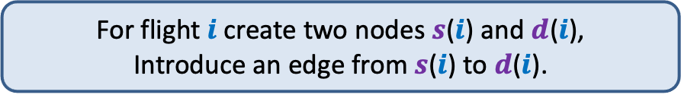


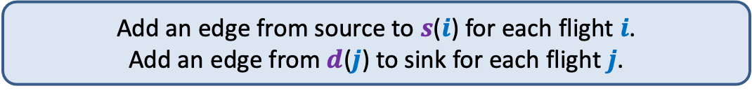
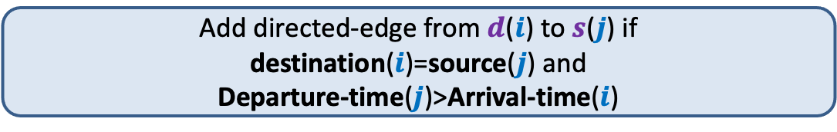
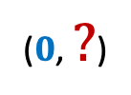
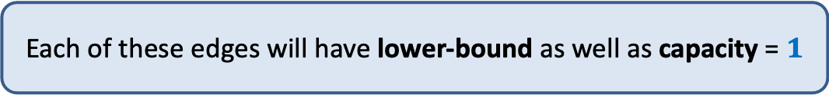

Constructing an instance of Flow with lower bound
($0$,$1$)
($1$,$1$)
($0$,$1$)
($0$,$1$)
($0$, $?$)
Add directed-edge from $d$($i$) to $s$($j$) if
destination($i$)=source($j$) and
Departure-time($j$)>Arrival-time($i$)
Introduce a source and a sink.
Add an edge from source to $s$($i$) for each flight $i$.
Add an edge from $d$($j$) to sink for each flight $j$.
For flight $i$create two nodes $s$($i$) and $d$($i$),
Introduce an edge from $s$($i$) to $d$($i$).
Each of these edges will have lower-bound as well as capacity = $1$

Slide 30
Constructing an instance of Flow with lower bound
($0$,$1$)
($1$,$1$)
($0$,$1$)
($0$,$1$)
($0$, $?$)
This will be one instance of flow with lower-bound.

Slide 31

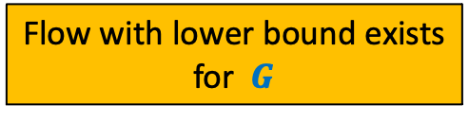


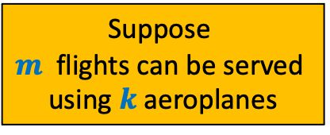



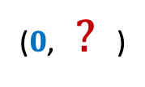

Constructing an instance of Flow with lower bound
($1$,$1$)
Suppose
$m$ flights can be served
using $k$ aeroplanes
$$G$$
How to compute the smallest number of aeroplanes ?
Flow with lower bound exists
for $G$
($0$, $?$)
>
$$k$$
$$1$$
$$3$$
$$2$$
$$4$$

